Slide 1


Slide 2
Team D Overview
The objective of our Web Application is to allow a wide variety of people to access reviews on songs that they might be interested in, then leave both quantitative and qualitative reviews for other users to read and interpret.
Our application will allow the user to save their favourite songs to a private list which can be accessed via user authentication. Following this the user will be able share their favourite songs with friends.
In addition, we will implement a Album suggestion feature that find similar songs that the user maybe hasn’t heard.
Users will be able to see the most popular albums on the website via a view count

Slide 3

User Persona #1
Marshall, a 33 year old engineer in the city, enjoys listening to Opera’s and Classical themed music when on the subway to work. However he finds the genre to be quite secluded in the world of music and difficult to find new and exciting pieces he might enjoy. He wishes there was an application that would help him find similar music to the ones he currently enjoys. In his free time Marshall also likes to sing and produce his own music. He wants to use an application that would allow him to share his music with like minded people and spread recognition about his music.

Slide 4

User Persona #2
Stacy is a retired banker, her guilty pleasure is Rock music. Her friends aren’t into the same genre of music and so she rarely hears of the new songs coming out. She also has a poor memory as she is suffering from age-onset dementia and cannot remember her favourite songs very well. So having a list of her favourite songs saved on her profile will help him remember. Using the website she can find new music to satisfy her taste and even share with her friends.

Slide 5
Requirements
User must be able to login and logout.
User must be able to edit details in their account as well as delete it.
User must be able to save a song to favourite songs list.
User must be able to watch or listen to the song via a YouTube API.
User must be able rate and review songs.
User must be able to search for favourite genre of music.
User should be able to make their favourite songs list private or public.
User must be able to add songs they may have produced into their private accounts.
User should be able to see which album they reviewed last

Slide 6
YouTube API
User
Client
Middleware
Database

Slide 7





Login
Register
Top Albums
Genres
Top Reviewers
New Album Release Feed:
Human – Rag’N’Bone Man
Recently Viewed Albums
The 1975
Beyoncé
Drake
Home About Site Map Sign In Contact Us

Slide 8








Top Albums
Genres
Top Reviewers
Human – Rag’N’Bone Man
Create A Review
Reviews: 56
Released: 2017
Genre: Soul/Blues
Length: 38:13
No. of Songs: 12
Label: Columbia
Average Rating:
4.7 / 5
Recent Reviews
JCMartin87 – 4/5
Johnjohnjoe – 2/5
anonymous – 4/5
Great vibe but a little slow at times. Spotify and chill with an attitude. Would recommend to anyone.
Unpopular opinion but this album fails to get off the ground. A few good tunes save this from disaster.
Pretty good
NEXT
Home About Site Map Sign In Contact Us

Slide 9








Top Albums
Genres
Top Reviewers
February 2017: Top 5 Reviewers
shadymarshallx Power of the Dollar – 50 Cent 1/5
1of the wurst albums ive evr heard wud give it 0 stars if i cud
StacyBrennan Nightmare – Avenged Sevenfold 5/5
Not the type of music I’d usually listen to but this was very enjoyable
anonymous Human – Rag’N’Bone Man 4/5
Pretty good
Home About Site Map Sign In Contact Us

Slide 10




Reviews: 7
Years Active: 1
Favourite Genre: Rock
Add Album
Settings
Sign Out
StacyBrennan
Top Albums
Genres
Top Reviewers
Last Review:
Nightmare – Avenged Sevenfold
Favourite Albums:
Avenged Sevenfold
The Offspring
Linkin Park
Home About Site Map Sign Out Contact Us

Slide 11
Walkthrough
Home
About
Top Albums
Genre
Account
Review Album
Top Reviewers
Register
Login
Site Map
Contact Us
Settings
Sign Out
Add Album

Slide 12
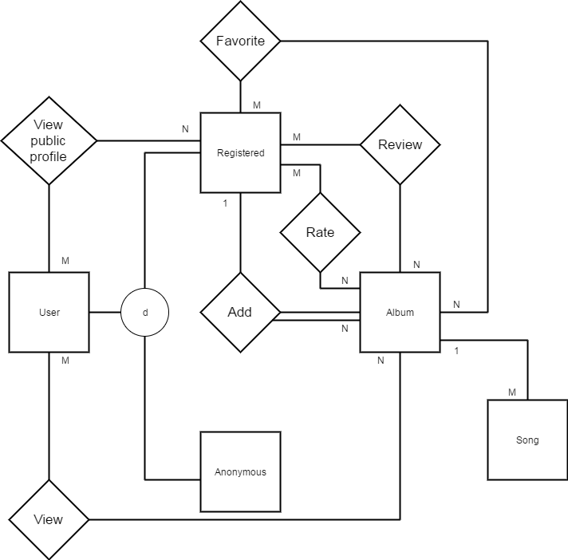

Slide 13
